Slide 1
RADAR on Roads
PIP2001 Capstone Project
Review-0
Batch Number: COM-11
Under the Supervision of,
Dr. Pajany M
Assistant Professor - SCSE
School of Computer Science and Engineering
Presidency University
Roll Number | Student Name
20211COM0063 20211COM0082 20211COM0078 20211COM0084 | K C VINDYA RUSHAB A R NIKHIL S MUKESH K A
Name of the Program: CSE
Name of the HoD: Dr. Blessed Prince P/Dr. Robin Rohit/Dr.Asif Mohammed H.B
Name of the Program Project Coordinator: Mr. Amarnath J.L & Dr. Jayanthi. K.
Name of the School Project Coordinators: Dr. Sampath A K / Dr. Abdul Khadar A / Mr. Md Ziaur Rahman

Slide 2
Content
Problem Statement
Analysis of Problem Statement
Timeline of the Project
References

Slide 3
Problem Statement Number: PSCS42
Organization: MindTree
Category (Hardware / Software / Both) : Hardwarre
Problem Description: There will be huge pile of vehicles waiting to pass through the toll booths over weekends around many cities. Though the NHAI has introduced FASTag RFID stickers, it still doesn’t address the issue. In many places its still not functional and at few it’s partially working. Places where it’s working, the vehicle needs to go slow so the sensors to detect the sticker and deduct the toll fare. What if we had a system which is similar or better to one being used in Dubai?
Difficulty Level: Complex

Slide 4
Analysis of Problem Statement
Technology Stack Components:
Hardware Layer:
Sensors – RADAR Sensors or Ultrasonic sensors
Microcontroller/Processor – Arduino or Raspberry Pi
Communication Module – WiFi (ESP32 or ESP8266)
Power Supply – Batteries
2. Programming Languages:
C/ C++
Python
JavaScript (Node. Js)

Slide 5
Analysis of Problem Statement (contd...)
3. Firmware/Embedded Software:
Arduino IDE: For writing and uploading C/C++ code to the microcontroller.
RADAR Libraries: Specific libraries for handling RADAR sensor data.
4. Frontend (Dashboard):
A web-based dashboard to monitor toll booth operations, traffic data, and transactions.
HTML/CSS/JavaScript: Core web technologies for building user interfaces.

Slide 6
Analysis of Problem Statement (contd...)
5. Backend & Server:
Node.js: A JavaScript runtime for building scalable backend services like managing vehicle data and processing toll payments.
Database: MySQL - Relational database for structured data.
6. Cloud Infrastructure:
AWS (Amazon Web Services) or Google Cloud: For hosting your server, database, and API services.

Slide 7
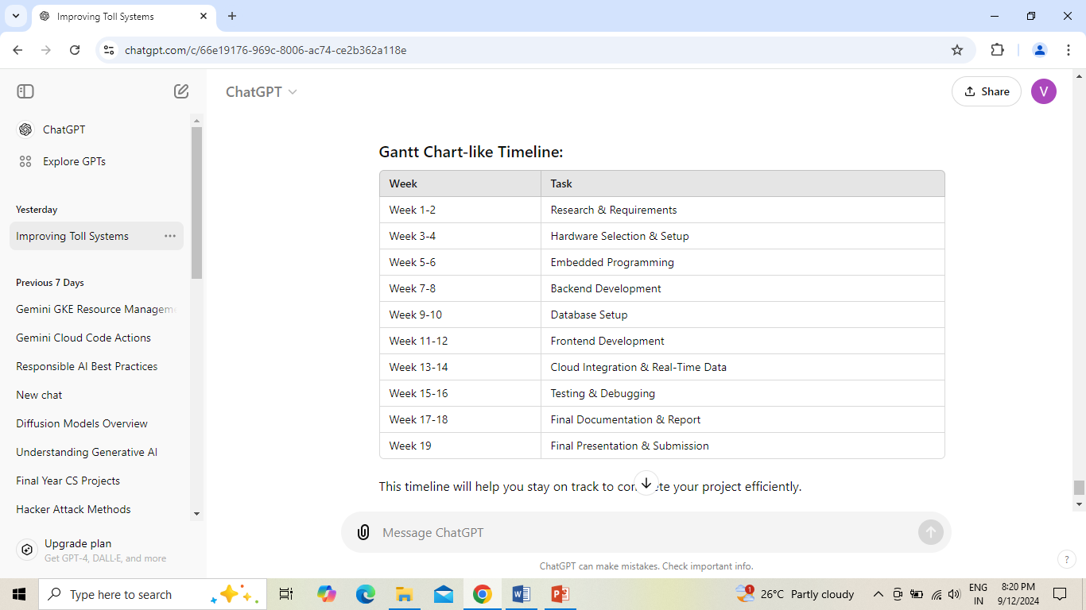
Timeline of the Project (Gantt Chart)

Slide 8
References (IEEE Paper format)
[1] Kesav Kaliyaperumal, Sridhar Lakshmanan, and Karl Kluge, Member, IEEE, "An Algorithm for Detecting Roads and Obstacles in Radar Images," IEEE Access, vol. 50, pp. 0018–9545, 2001.
[2] Tae-Yun Lee , Vladimir Skvortsov, Myung-Sik Kim, Seung-Hoon Han, and Min-Ho Ka , Member, IEEE, "Application of W-Band FMCW Radar for Road Curvature Estimation in Poor Visibility Conditions," IEEE Access, vol. 18, pp. 1558-1748, 2018.
[3] Xiaolin Tang and Zhiqiang Zhang, Yechen Qin, "On-Road Object Detection and Tracking Based on Radar and Vision Fusion: A Review, 2022.
[4] Ramona Behrendt, "Traffic Monitoring Radar for Road Map Calculation ," 2016, pp. 978-1.
[5] David Felguera-Martín, José-Tomás González-Partida, Pablo Almorox-González, and Mateo Burgos-García, "Vehicular Traffic Surveillance and Road Lane Detection Using Radar Interferometry, vol. 61, pp0018-9545, 2012.

Slide 9


